Slide 1
Employee Attendance
Management

Slide 2
Table Of Contents
Introduction
Process Flow
Attendance Request /
Correction
Attendance Report

Slide 3
1. Introduction

Slide 4
1.1 Overview
With the implementation of the new My Time Tool, you would have an automated system to apply for attendance regularization/correction.
This tool would allow you to:
Apply for attendance regularization from any location, via internet or intranet
View attendance requisition history
View status of applied request .i.e. approved/Rejected/In progress
Minimize the possibility of errors
Will provide a single platform to your supervisor to take actions on the attendance requests received

Slide 5
1.2 Learning Objectives
After completing this module you will be able to do the following:
View and Apply for Attendance Requests/correction
Correct your attendance, subject to manager’s approval
Check your leave request status
1.3 Technological Requirements
Laptop/Desktop
Internet/Intranet
Access to Genpact CM India Employee Self Service > My Time Tool

Slide 6
2.1 Process Flow

Slide 7
2.1 Attendance Application Process Flow
Login to G Social > Tools > My Time Tool
Manager Actions
Auto Trigger to employee if:
Attendance Request
Below records get updated:
Approve
Reject
Delegate/Re-Assign
Approved
Rejected or
Delegate/Re Assign
Attendance Request
Notification/ Auto-Trigger to Approving Manager
3
4
1
2

Slide 8
2.1.2 Scenarios for Attendance Management
Attendance Request
Attendance Correction
Attendance Cancellation
Acquisitions and Re-Badging
Assessment Centers/External Exams
Backdate on-Boarding
Bulk Movement
Business Movement
Card not brought
Changing Building
Client Holiday
Client Site
Comp Off
Employee on Bench
Employee on NHO
Employee on Suspension / Exited Emp.
IT Issue
Internal Transfer
Local Travel
Loss of Card
OJT / Offsite / Out Duty
Part Timer
Process Movt/Assignment
Seminar / Training
Week Off
Work From Home
Loss of card
Back Dated WFH
Client holiday
On site Project
Applied for Leave on a future Date, but need to cancel the request

Slide 9
3.1 How do I regularize / Correct my attendance?
Attendance regularization should be selected if you are requesting for attendance regularization within 15 days of date of transaction
Attendance correction should be selected if you are requesting for attendance approval post 15 days of date of transaction

Slide 10


You can go to the new My Time Tool through following 2 ways:
1
2
My Time-India
Employee Self Service

Slide 11
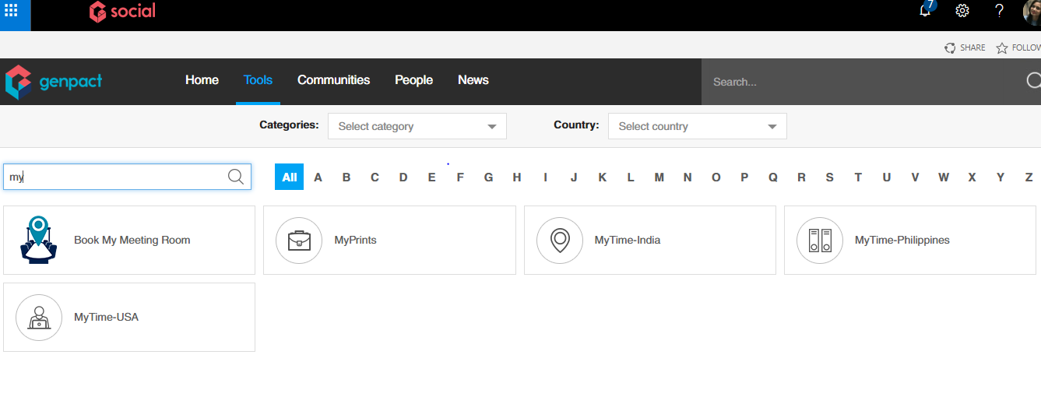
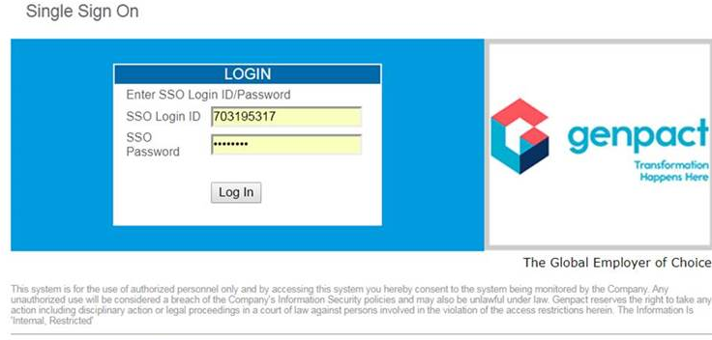
Step 3.1.1
OPTION 1
Go to Tools
Go on My Time-India
Enter SSO ID and Password
Click on Login to button to go to User home page

Slide 12
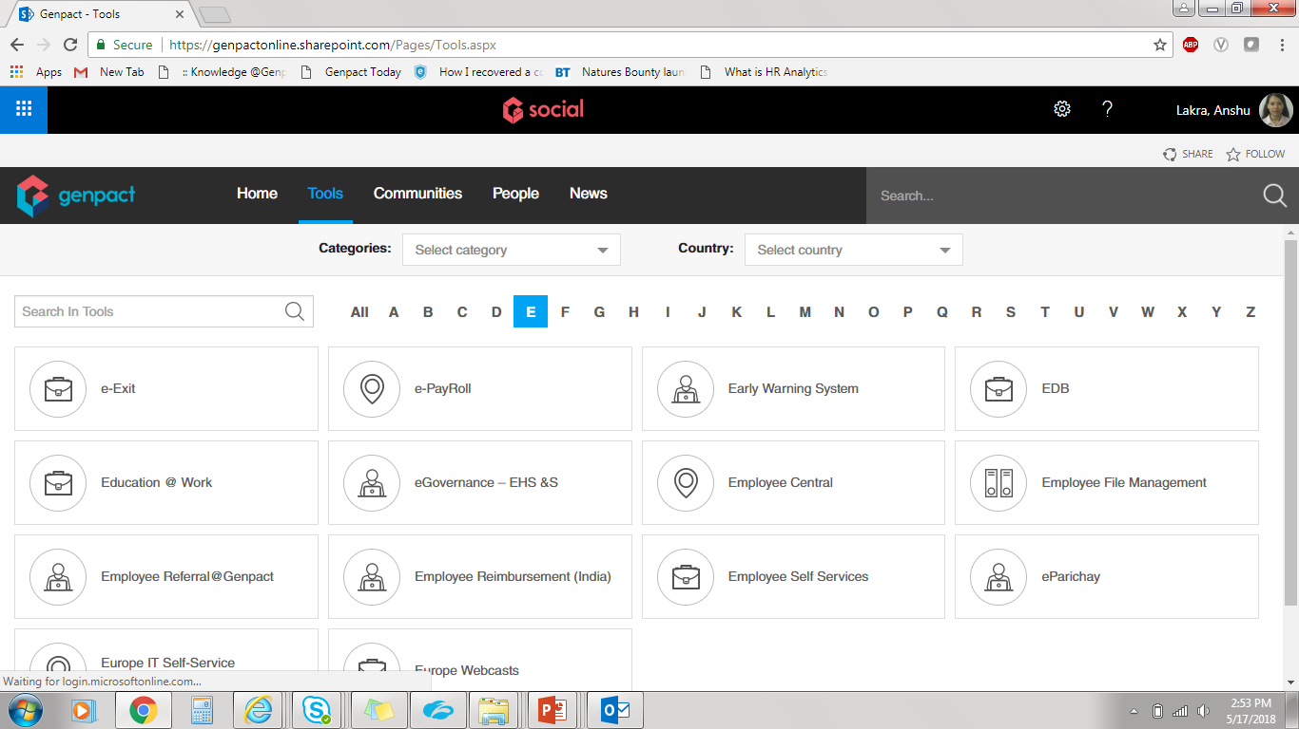
Step 3.1.2
OPTION 2
Go To Tools
Go on Employee Self Services
Enter SSO ID and Password
Click on Login to button to go to User home page

Slide 13
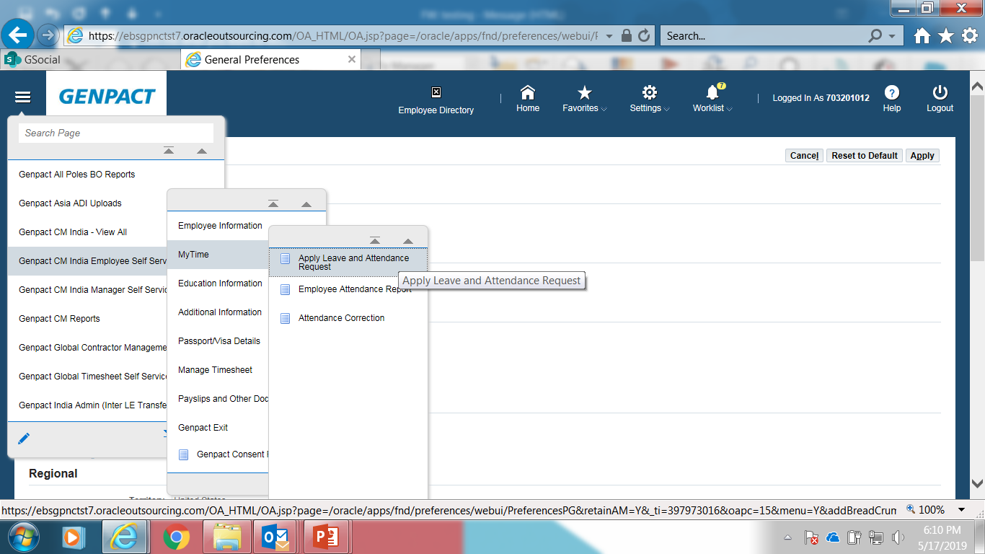
Step 3.1.3 (Attendance regularization)
You can click on Navigator on home page
Click on Genpact CM India Employee Self Service
Go to My Time
Click on Apply leave and attendance request for attendance request

Slide 14
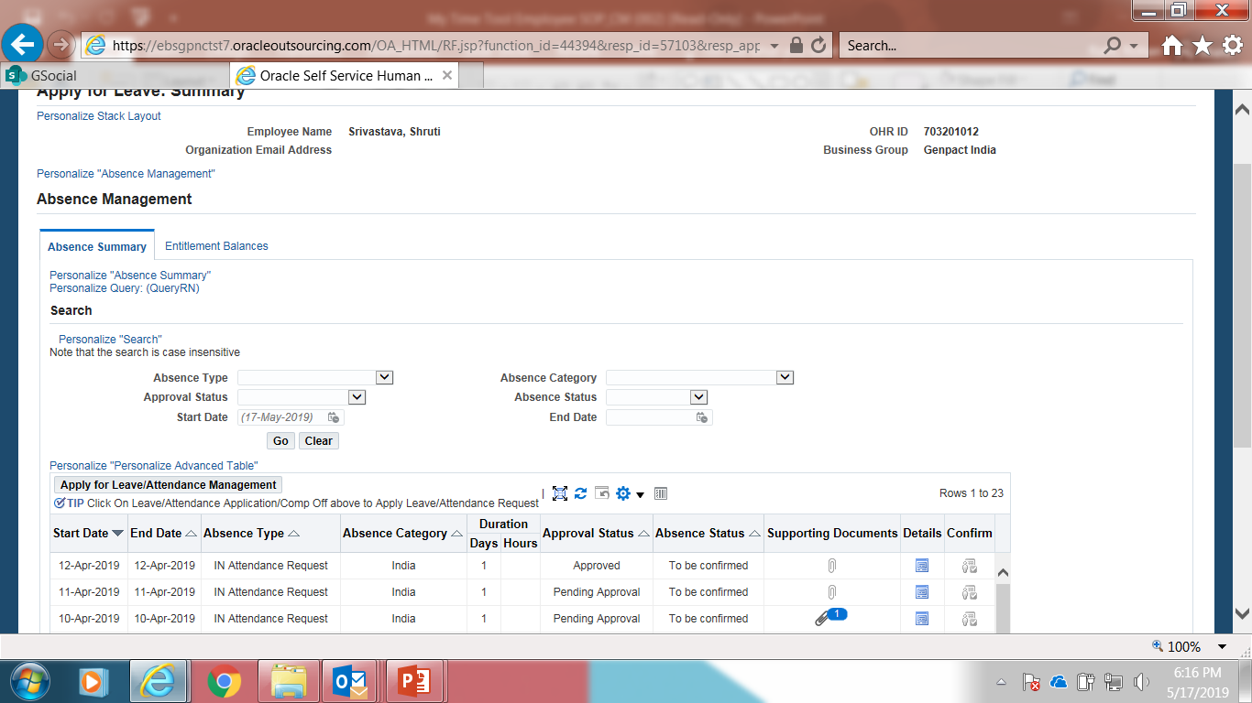
Step 3.1.4 Click on ‘Apply for Leave/Attendance Management” to Apply Attendance request
Notes:
Click on ‘Leave/Attendance Application/Comp Off” button to apply leave, mark attendance or avail comp off.

Slide 15
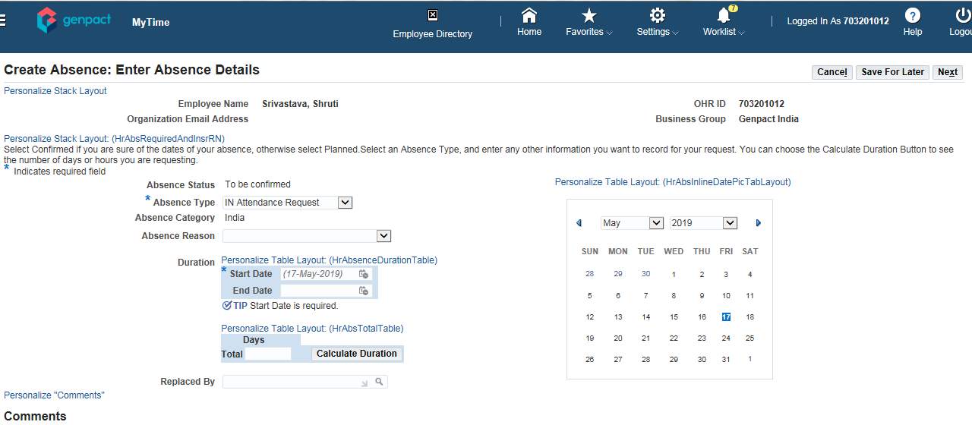
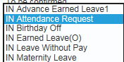
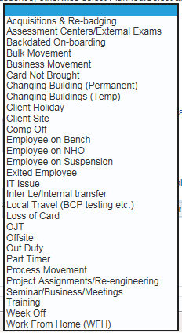
Step 3.1.5
Select Attendance Type as IN Attendance Request
Select appropriate attendance Reason from the drop down in absence reason.
Enter Start Date and End Date in DD-MMM-YYYY (12-May-2018) format only
Click on total box with cursor blinking. Then click on calculate duration.
Calculate Duration - The number of attendance days will be calculated automatically
Click on Next
Notes:
Navigate to Apply Leave/Attendance request page
Select Leave Type as Earned Leave
Enter appropriate Leave Reason from LOV of reasons
Enter Start Date and End Date
Calculate Duration(Optional)
Enter Comments (Optional)
Add Attachment (Optional)
Click on Next

Slide 16
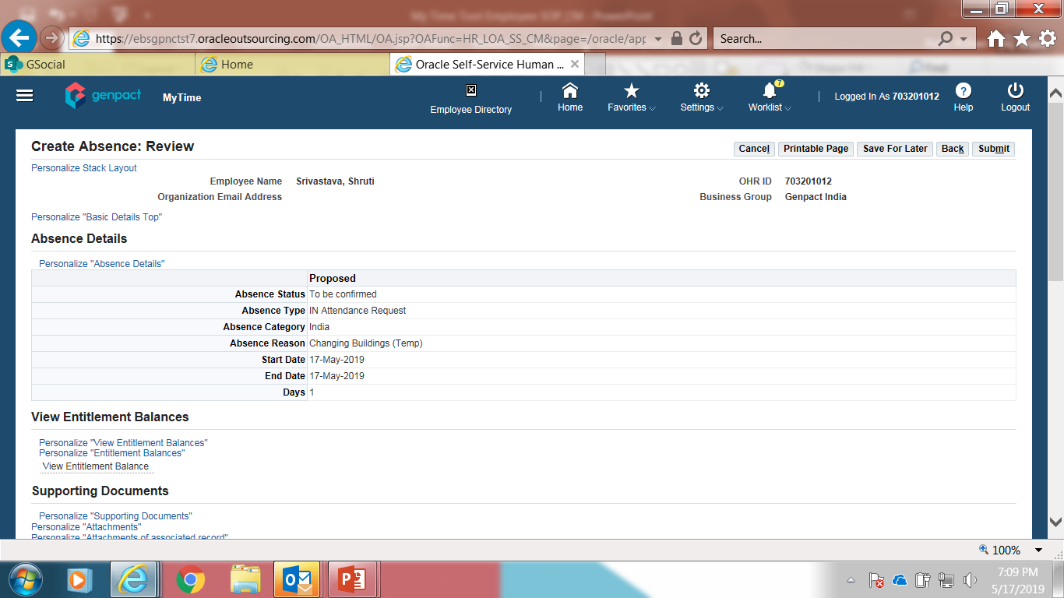
earned leave - review
Step 3.1.6
You will come to the review page which will show you the Absence Status, Absence Type, Absence Category, Absence Reason, Start-End Date, Days of Absence.
Note: At this stage, if you want to make changes, you could click Back to go back to the previous screen or click Submit.
Notes:
Review the details of the request applied
Click on Submit button to send request for approval
Click on Back button to go back to Leave request page

Slide 17
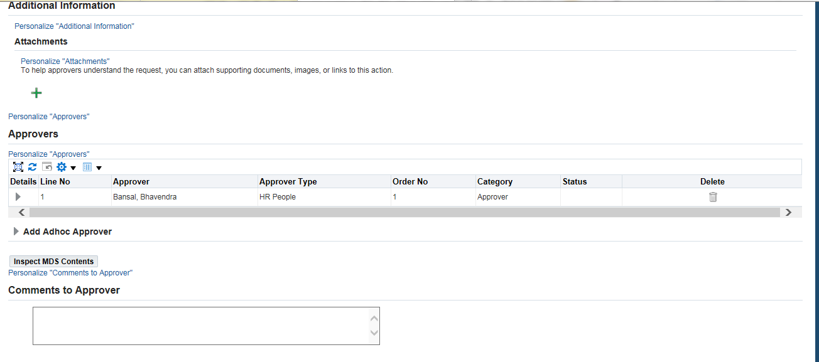
APPLY MATERNITY LEAVE
Step 3.1.7
You can also scroll down in order to Verify the approver before submitting the request if needed.
The approver name is the employee supervisor.
Click on “Submit” button to complete attendance request.
Notes:
Verify the approver before submitting the request if needed.
The approver name is the employee supervisor.
Click on “Submit” button to complete leave request.

Slide 18
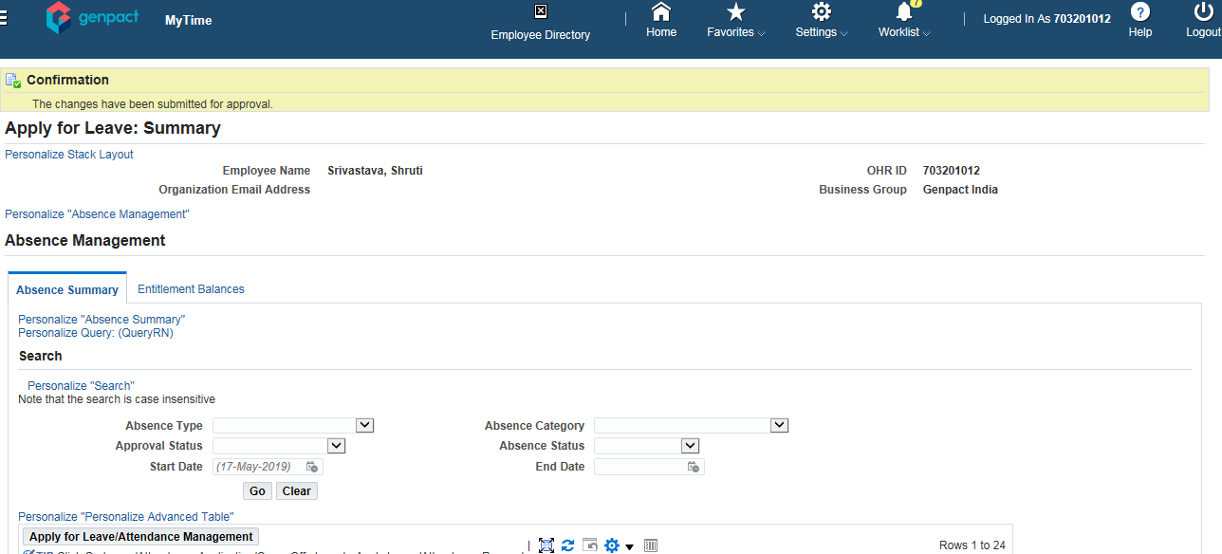
Apply earned leave – submission confirmation
Step 3.1.8
You can see that the attendance has been submitted for approval
Notes:
Check the leave status on Summary Page

Slide 19
Step 3.1.9 (Attendance correction)
You can click on Navigator on home page
Click on Genpact CM India Employee Self Service
Go to My Time
Click on Attendance correction

Slide 20
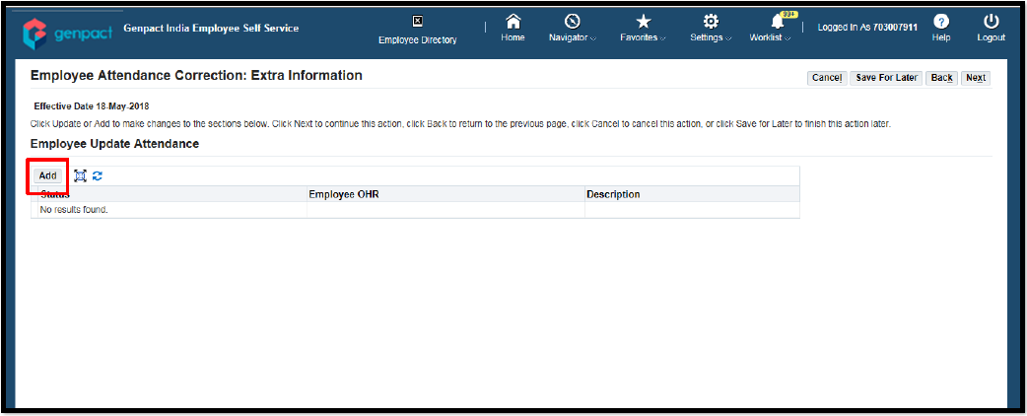
Step 3.1.10
Click on “Add” button

Slide 21
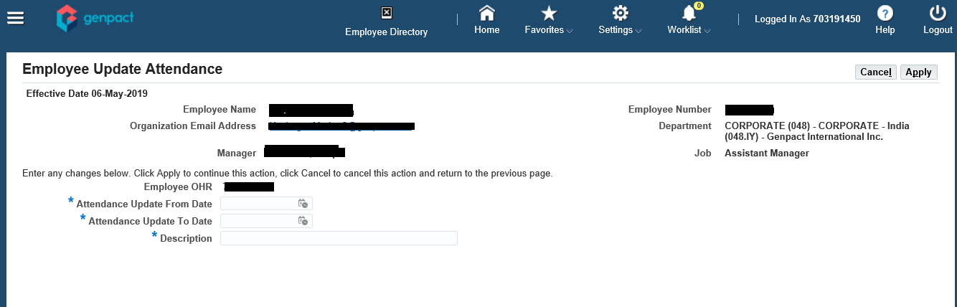
Step 3.1.11
Logged in employee OHR will automatically reflect.
Select the date for which Attendance needs to be updated.
Provide the reason to update the attendance
click on apply button

Slide 22
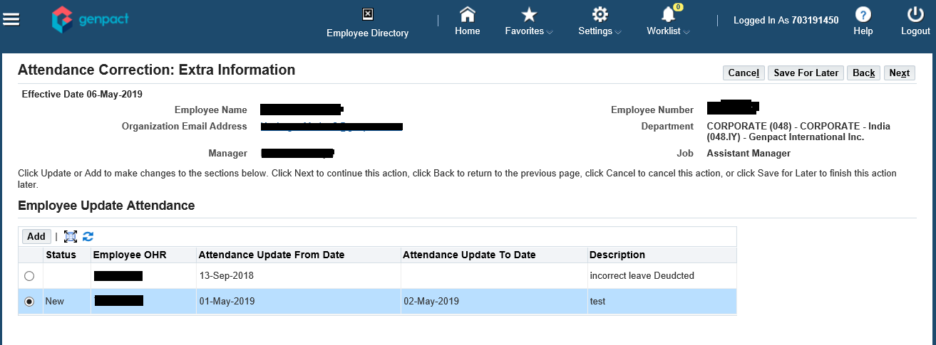
Step 3.1.12
A new row will be added as shown with ‘Status’ as ‘New’.
Select ‘Next’
Here can Correction/cancel/request

Slide 23
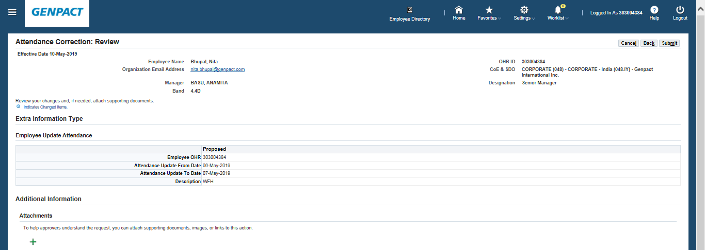
Step 3.1.13
Review the ‘Proposed’ information and click on ‘Submit’ button.

Slide 24
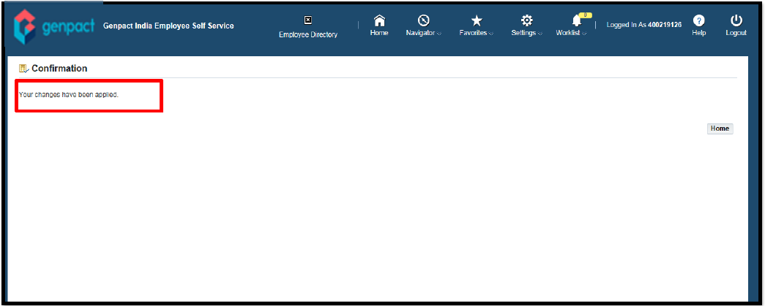
Step 3.1.14
A confirmation message will be displayed for request submission, and the same will be routed to supervisor approval.
Post supervisor approval, Attendance will be updated next day and the same can be checked in employee’s ‘Attendance report’

Slide 25
3.2 How to pull your Attendance report?
Note: Data from 20th May Onwards will be visible in the report

Slide 26
Step 3.2.1
You can click on Navigator on home page
Click on Genpact India Employee Self Service
Go to My Time
Click on Employee attendance report

Slide 27
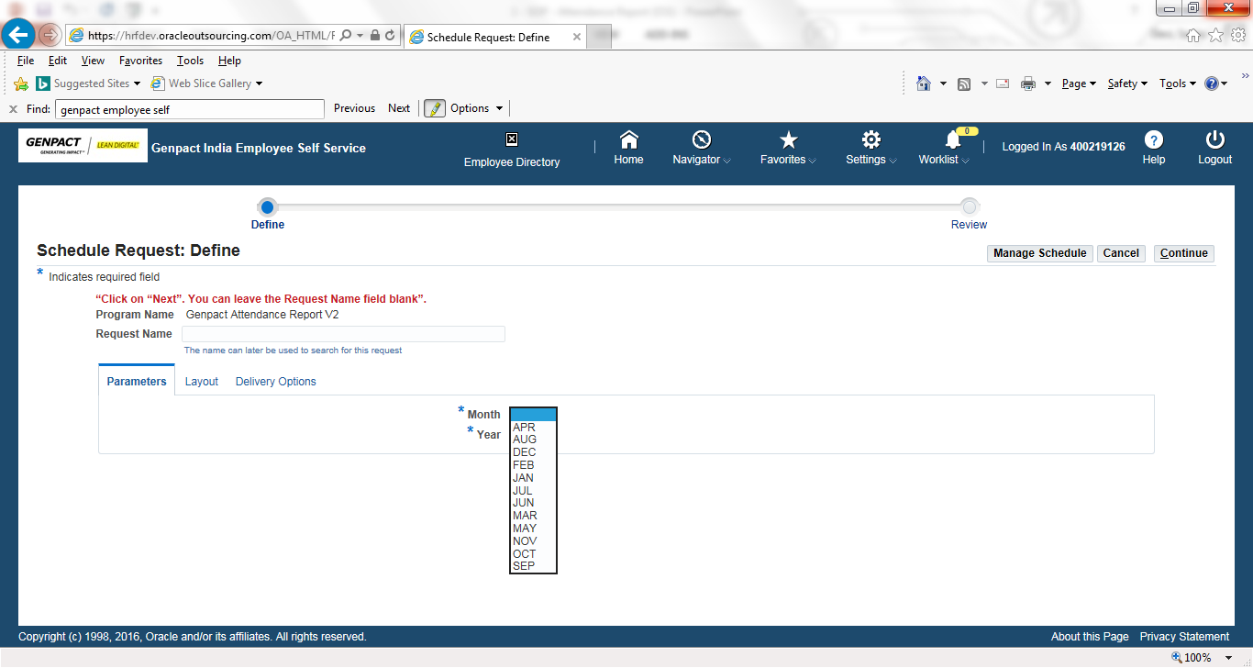

Employee’s attendance report
Step 3.2.2
Select the month for which the attendance needs to be checked.
Select current calendar year in “Year” field.
Click on “Continue” button.

Slide 28
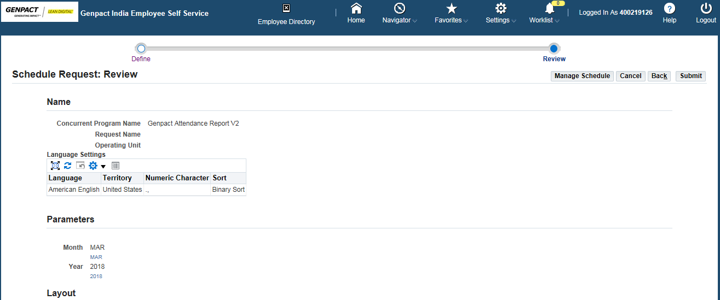
Employee’s attendance report
Step 3.2.3
Click on ‘Submit’ button

Slide 29
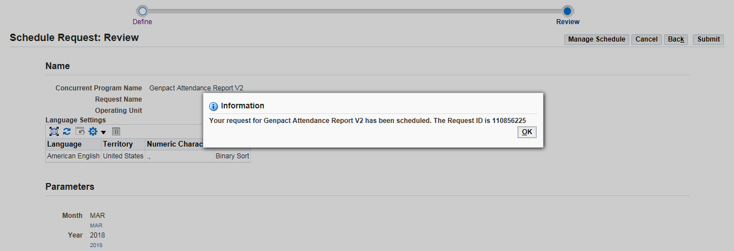
Step 3.2.4
Click ‘OK’

Slide 30
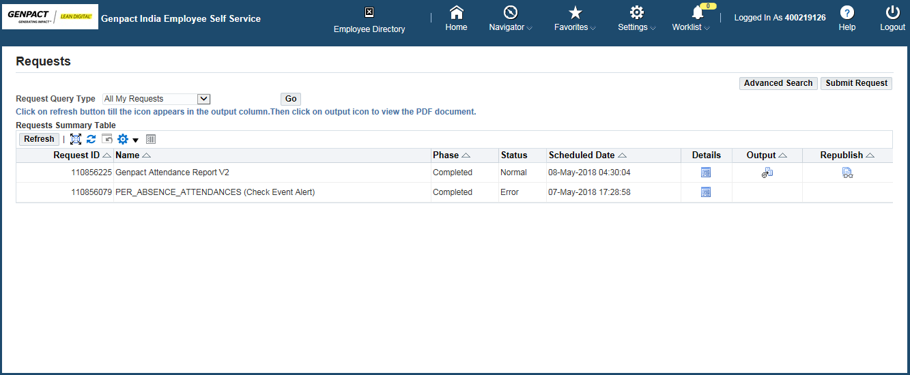
Employee’s attendance report
Step 3.2.5
Click on ‘Output’ icon to View the report.
Note - In case the output icon is blank, click on ‘refresh’ icon (follow Arrow) to generate the output. Once the output is displayed, click on the same to check the attendance report.

Slide 31
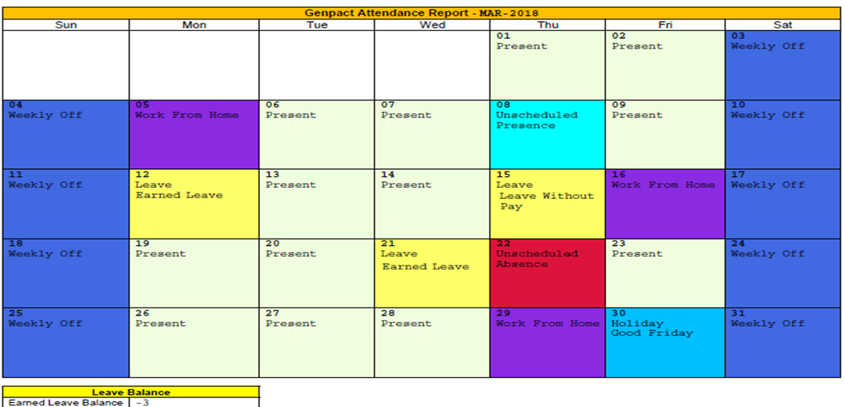
Employee’s attendance report
Step 3.2.6
The report will show employee’s selected month’s attendance details along with Earned Leave balance.

Slide 32
Thank you

